Slide 1

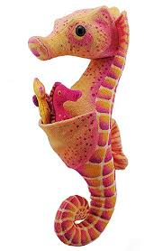
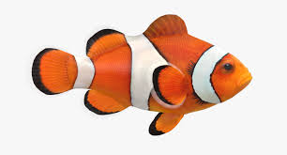


Your Child in Year 1/2
Wednesday 11th September 2019
Teachers:
Mrs Frear, Miss Davies, Mrs Hillerton & Mrs Ebenezer
LSAs: Mrs Martyn, Mrs Horvath, Mrs Houlton,
Miss Kelly, Mrs Gibbons, Miss Campbell

Slide 2

Transition
In Key Stage 1 we encourage the children to develop their independence.
Please can we ask that after Friday 13th September children are encouraged to come round to the classrooms independently.
We would like the children to take responsibility for their own belongings. E.g. putting their communication books and Reading books in the correct boxes.

Slide 3

Independent Children
Establishing routines at the start of the day:
Blue communication diaries and home reading books to be handed in every day.
Home reading book can be changed as and when it is necessary for your child. Children need to tell their adults that they have changed their books so they can be ticked off.
Homework books are handed out on Fridays and need to be handed in the following Thursday.
Letters or notes need to be handed to the teacher.
Blue folder on their pegs.
Water bottles / snacks in the boxes.

Slide 4
Independent Children
Establishing routines at the end of the day:
Take home reading and blue communication books.
On appropriate days, take home homework book.
Collect lunchbox and coats.
Collect letters when appropriate.
P.E kits are sent home at the end of every half term.
Communication notes and ‘what we will be learning next week’ will be sent home every Friday in their blue communication book.
Homework can also be found on the school website.

Slide 5
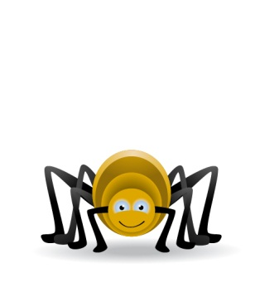
Year 1/2 Topics
Autumn: Fire
Spring: All Around The World
Summer: Seaside and Oceans
These may overlap due to SATS preparation.

Slide 6

Educational Visits
Autumn: Trip to St. Paul’s Cathedral?
Spring: Trip to Marwell Zoo
Summer: Trip to Southsea Aquarium
We will be looking for extra help on our trips so if you are available and are DBS checked please let us know. ☺

Slide 7

Helping in School
Parents and/or grandparents.
Reading, numbers, computer, trips, nativity (particularly sorting costumes), ICT.
You will be asked to work with the year group, but not necessarily directly with your child.
Forest Schools (walking to and from the forest and participating in activities).
All adults must be DBS Checked

Slide 8
Behaviour
We ALWAYS commend good behavior- this could be something small or something outstanding.
Star of the week (a child who has wowed us in the week) will join the Tea party with Mrs Peters or Miss Mohain.
Children who are respectful/helpful will be rewarded house points or raffle tickets.
Rainbow stickers will be awarded for outstanding work or effort.

Slide 9

Behaviour System
Just a few reminders about our behaviour system:
Children are put on the rainbow when they do something/behave in a way that goes above and beyond what is expected.
Where every child will begin at the start of everyday. ☺
Bad choices will result in a child receiving a verbal warning.
If the behaviour persists their initials will be written on the board.
Ticks (maximum of 2) will be added to the initials if the behaviour continues.
For any serious behaviour / recurring minor behaviour your child will be sent to a member of the Senior Leadership Team.

Slide 10

A Weekly Timetable
PE ~ Monday/Thursday and Wednesday afternoons will be taught by the class teachers or the PE co-ordinator.
Literacy, Maths and Phonics will be taught every day. After half term the children will also be taught Guided Reading 4x a week.
Reading ~ Children will read to an adult at least once a week.
The children will be attending Forest Schools once a week. This will be either Mondays or Thursdays.

Slide 11
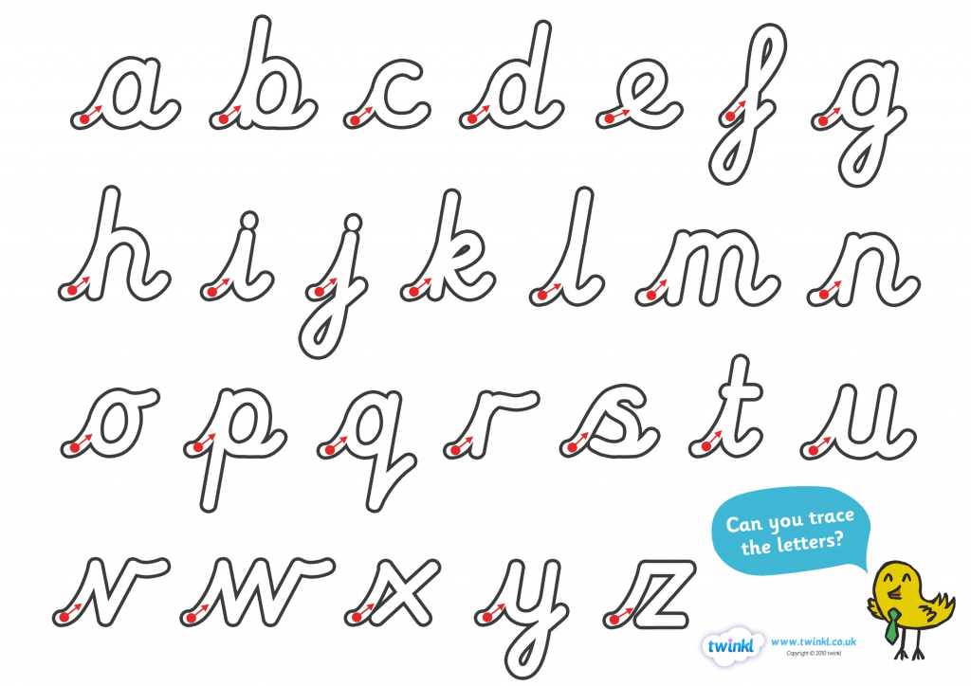
Handwriting
As a school we have a strong focus on handwriting.
We will be teaching pre-cursive handwriting and once the children are ready we will teach them how to join their letters.

Slide 12
P.E
Ensure all kits are named and in school.
Navy tracksuits are encouraged as the weather gets colder.
Hair must be tied back and tape placed over earrings. Please can tape be provided for earrings.
Spare socks should be kept in P.E bags
A coloured t-shirt to match your house

Slide 13
Blue Communication Books
If you have a message in the morning please write the message in the book instead of coming to the classroom.
We will use them to communicate with you. Please check them everyday.
Please return them to school on a daily basis.
Make sure your child is aware of any notes, so they remember to hand it to the teacher / put on step.
Please sign every week.

Slide 14
Reading with Your Child
Words are everywhere!
Encourage success.
Changing books.
Word games.
Comprehension and inference.

Slide 15
Phonics
Some of the lingo you may be hearing at home:
Phoneme ~ the sound
Grapheme ~ how the sound is written
Diagraph ~ a phoneme made up of 2 letters (ai)
Trigraph ~ a phoneme made up of 3 letters (igh)
Phoneme buttons ~ marking the number of phonemes in a word (this can help with reading and spelling)
tin with rain night liquid

Slide 16

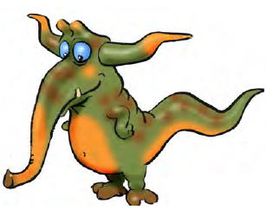
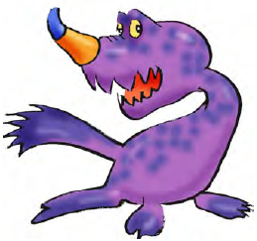
Phonics Screening
We do ask children to read words that are not real but are made up from learnt phonemes.
We call these nonsense/alien words.
These help test their recognition of these phonemes and check they are decoding words properly.
pog
tomp
bock

Slide 17
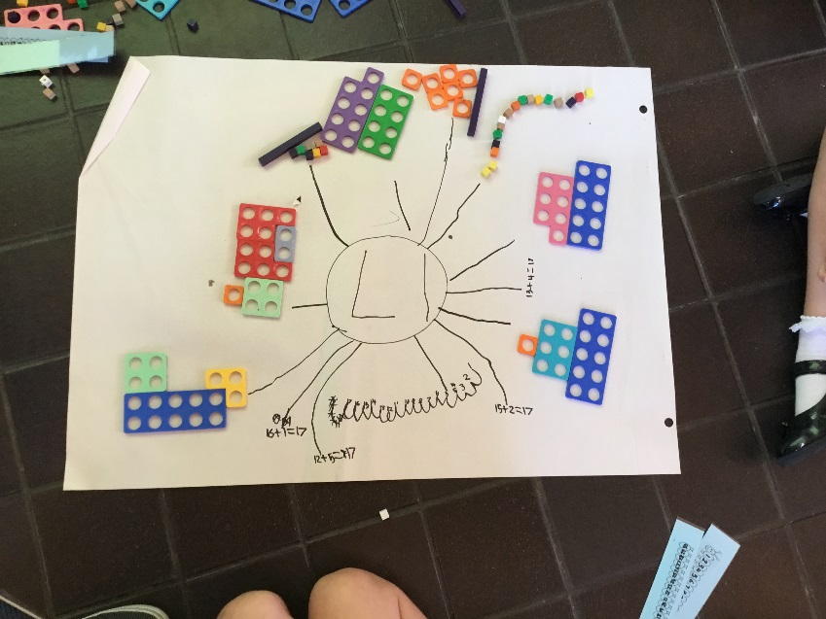
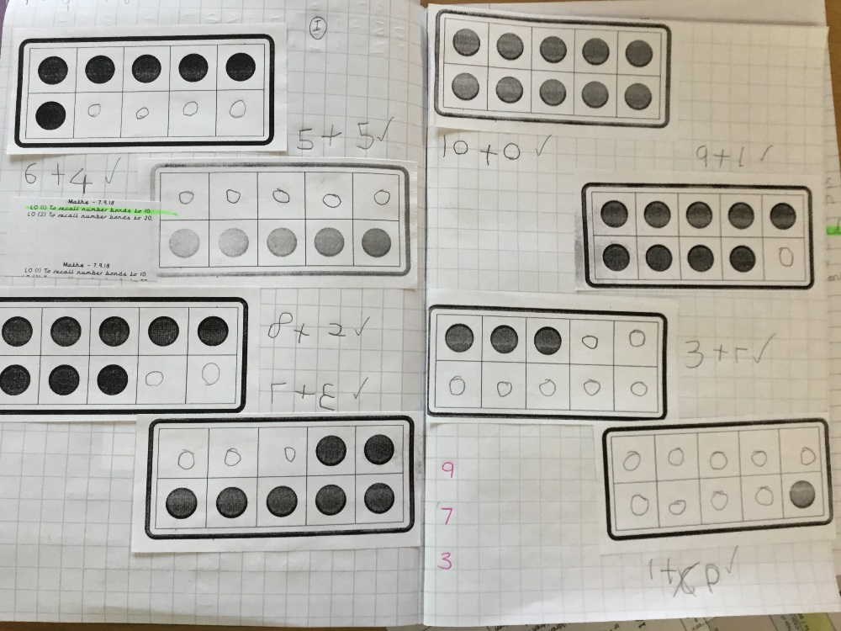
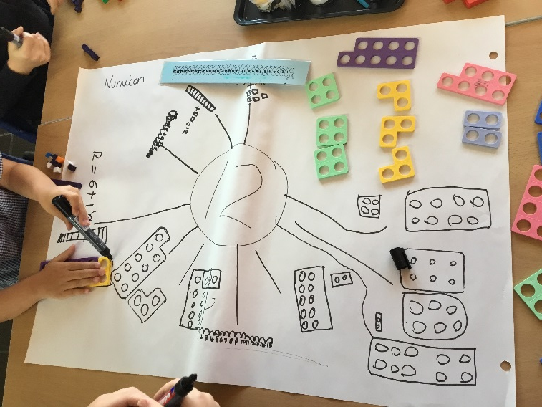
Year 1/2 Maths
Year 2 – Number bonds work
Year 1 – Number bonds work

Slide 18
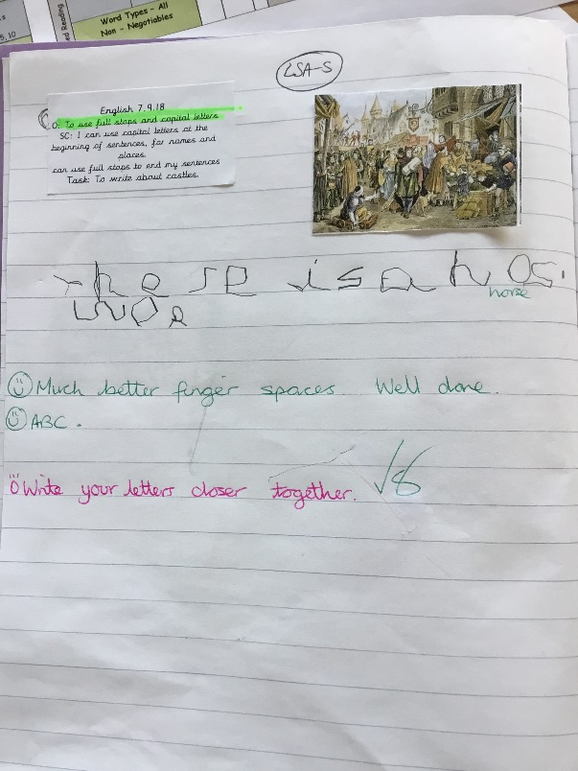
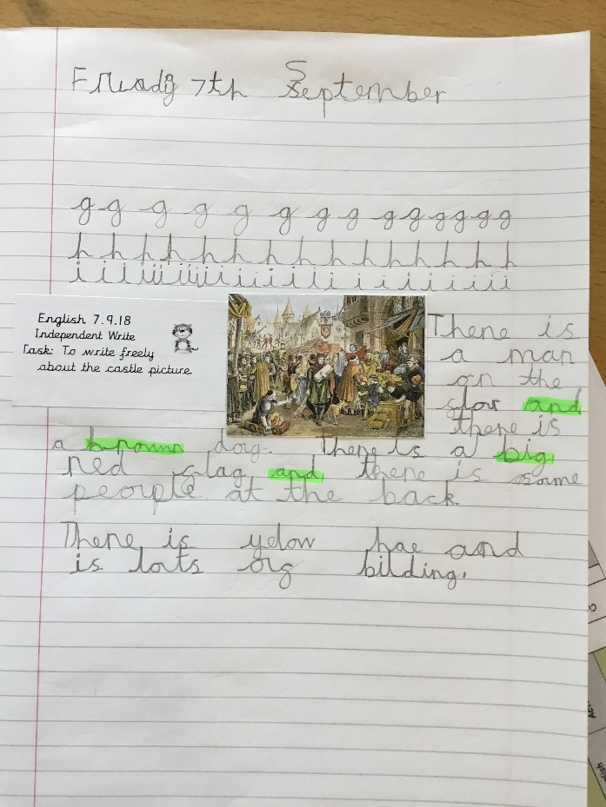
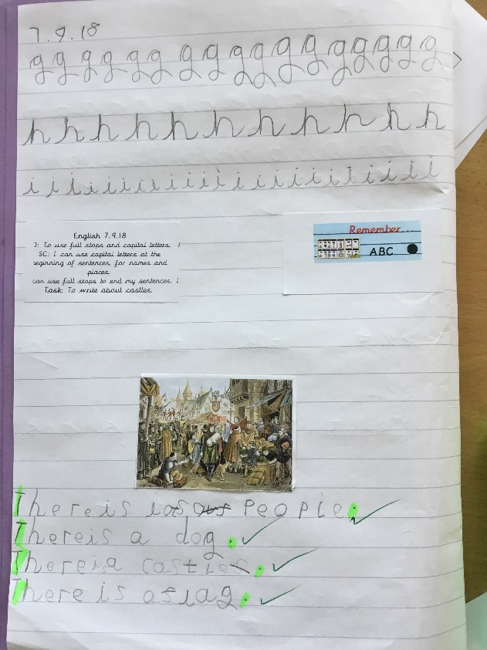
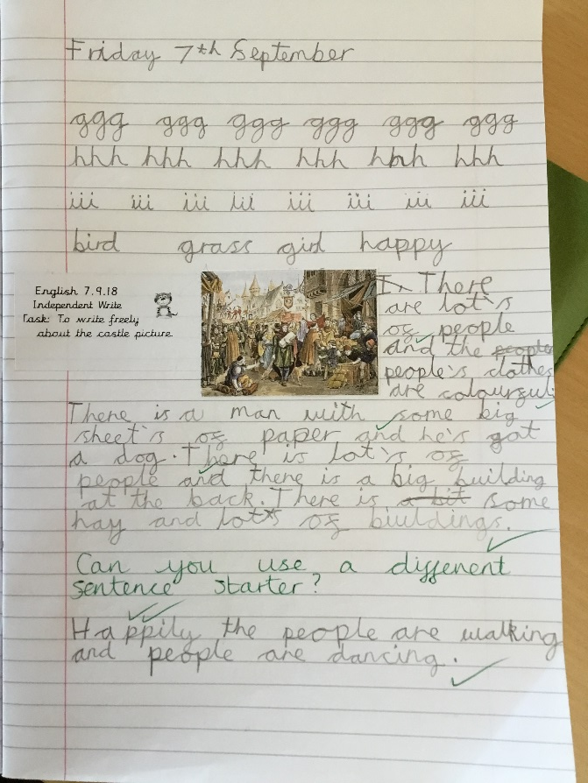
Year 1/2 Writing
Year 1 – Writing – To use capital letters and
full stops.
Year 2 – Writing – To use adjectives,
verbs and conjunctions.

Slide 19

SATS – Year 2
Statutory Assessment Tasks.
Every child must do these at the end of year 2.
There is lots of preparation for this.
Special Agent Training.
There should be no stress!

Slide 20
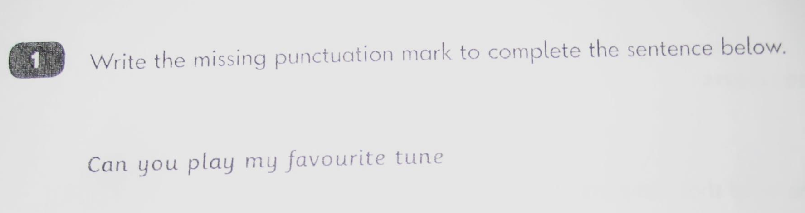
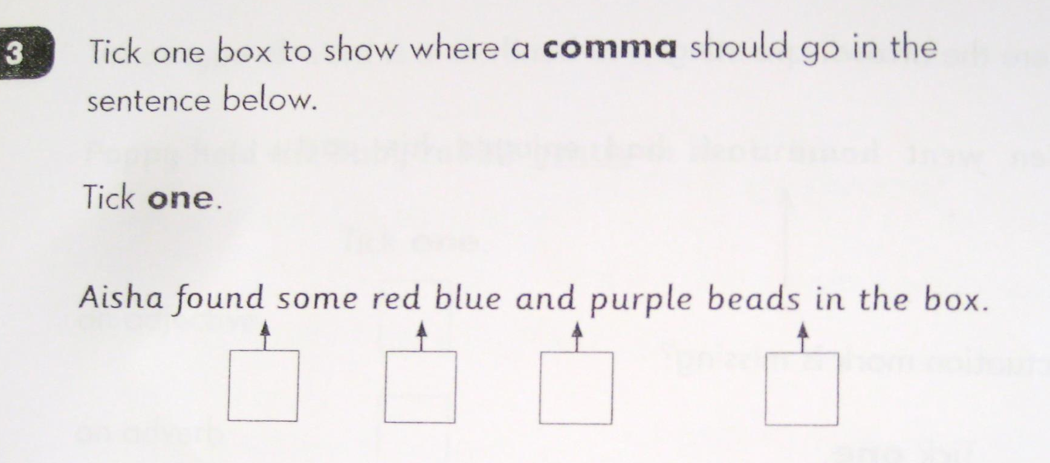
Grammar

Slide 21
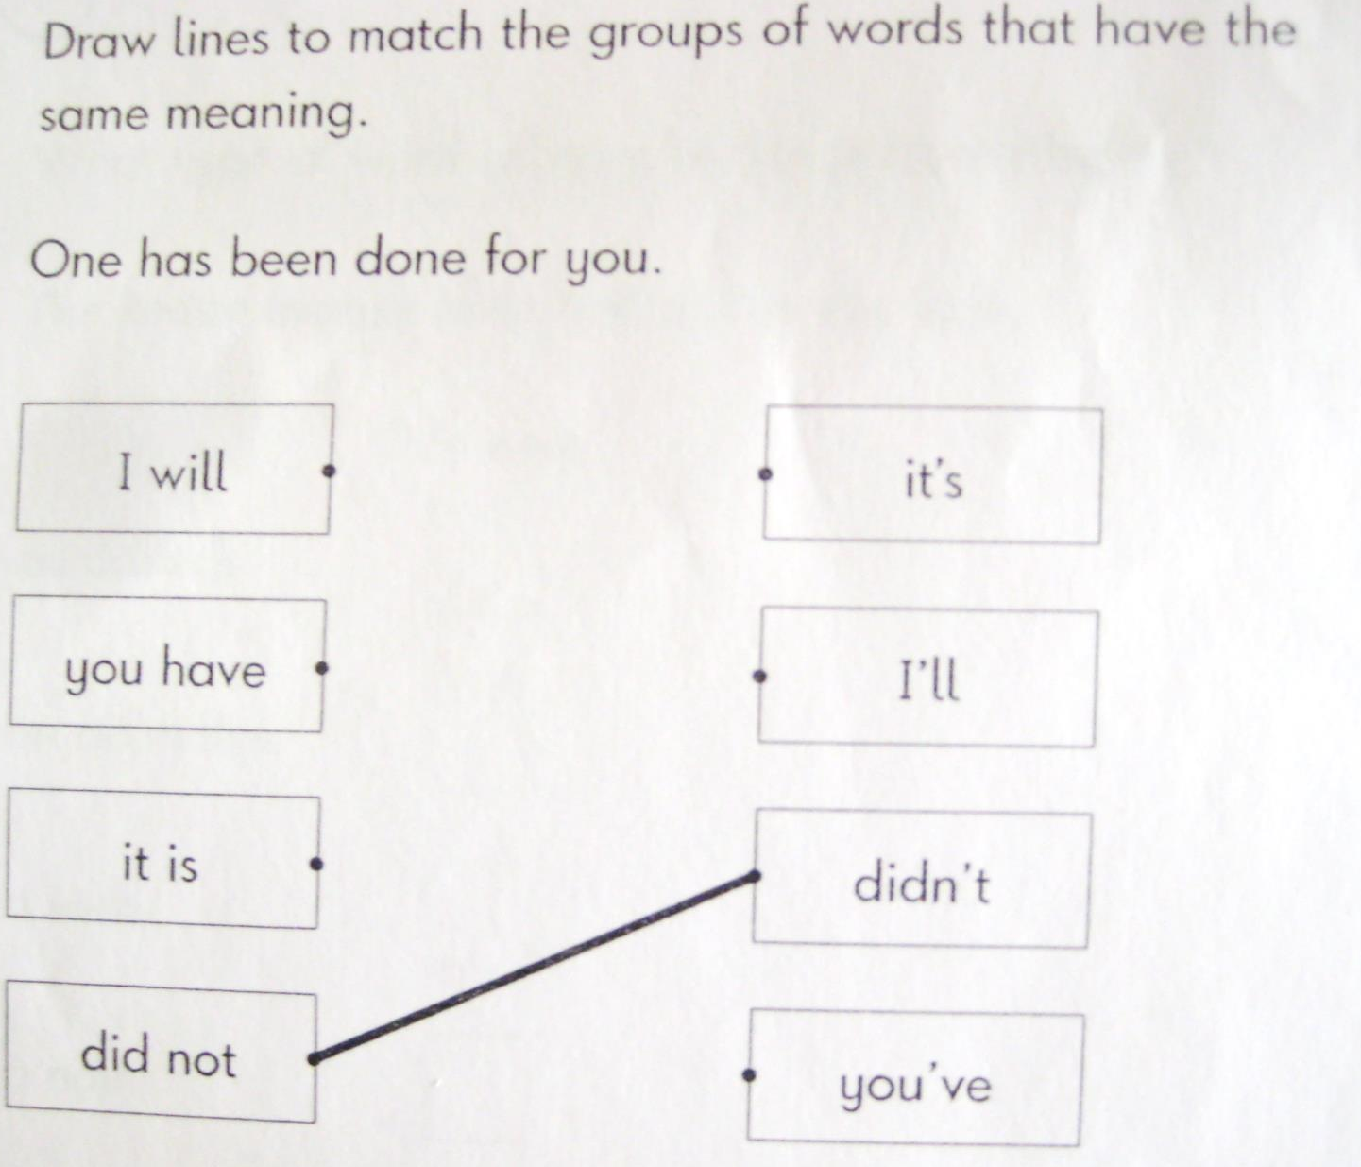
Grammar

Slide 22
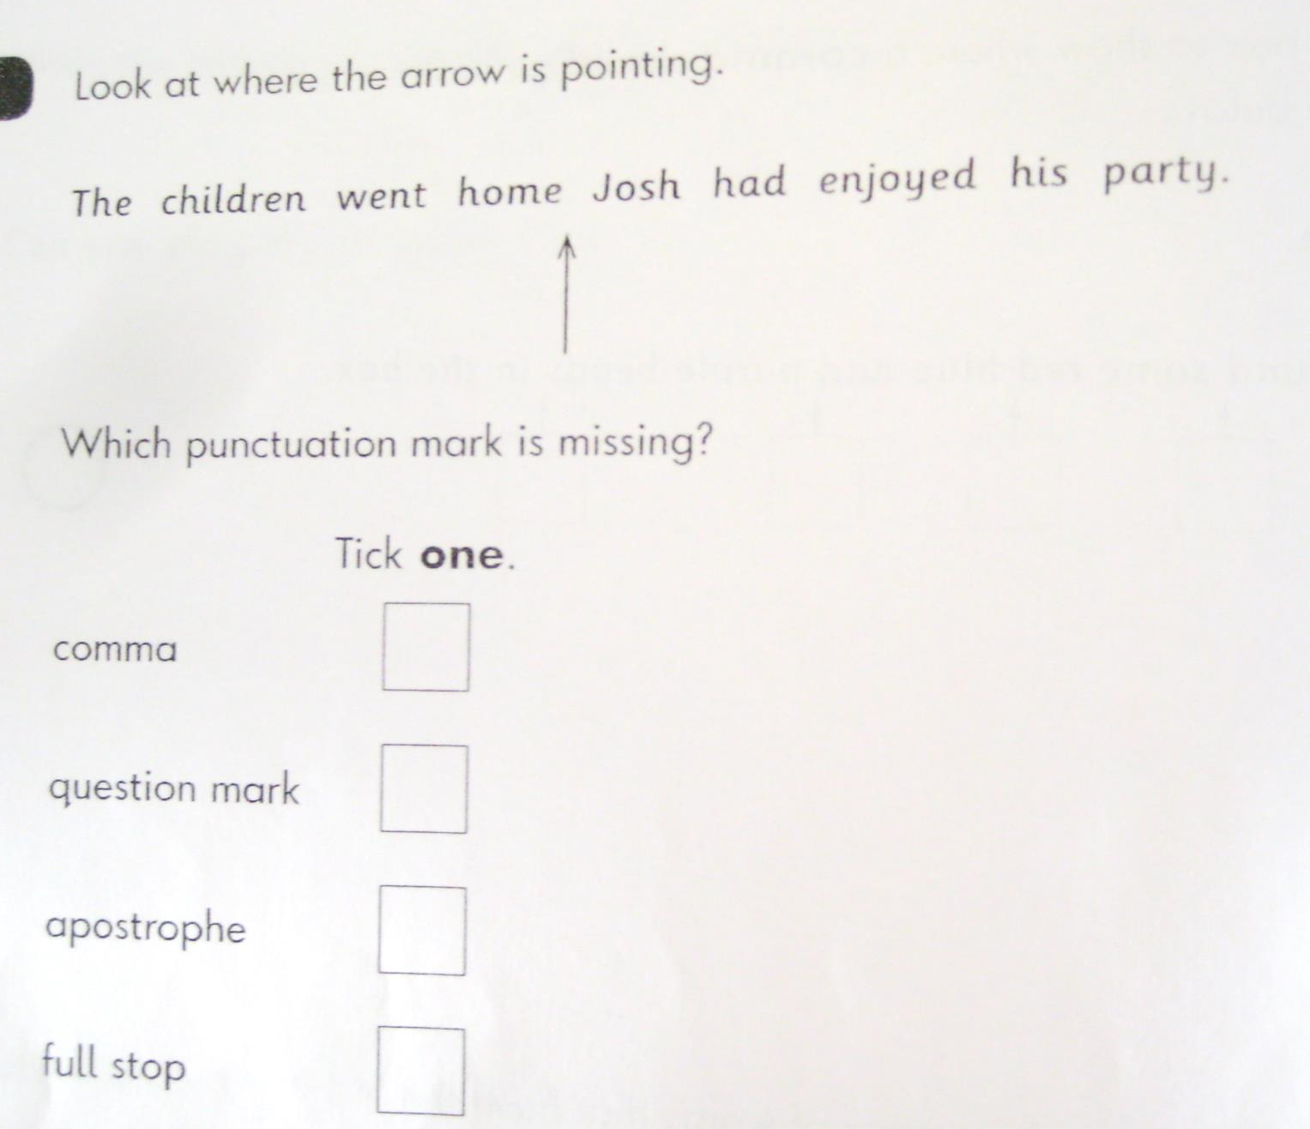
Grammar

Slide 23
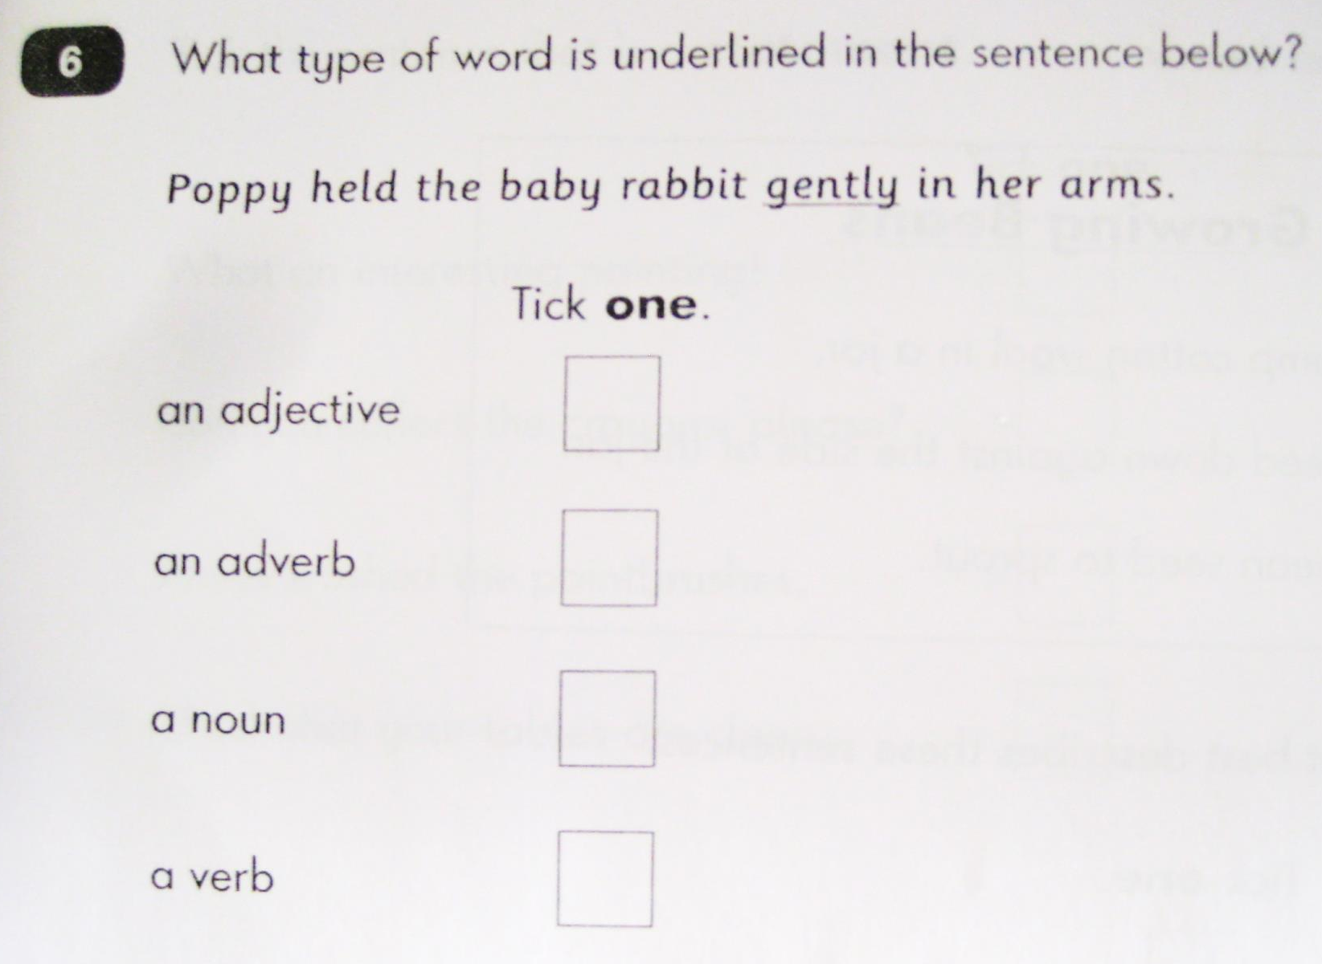
Grammar

Slide 24
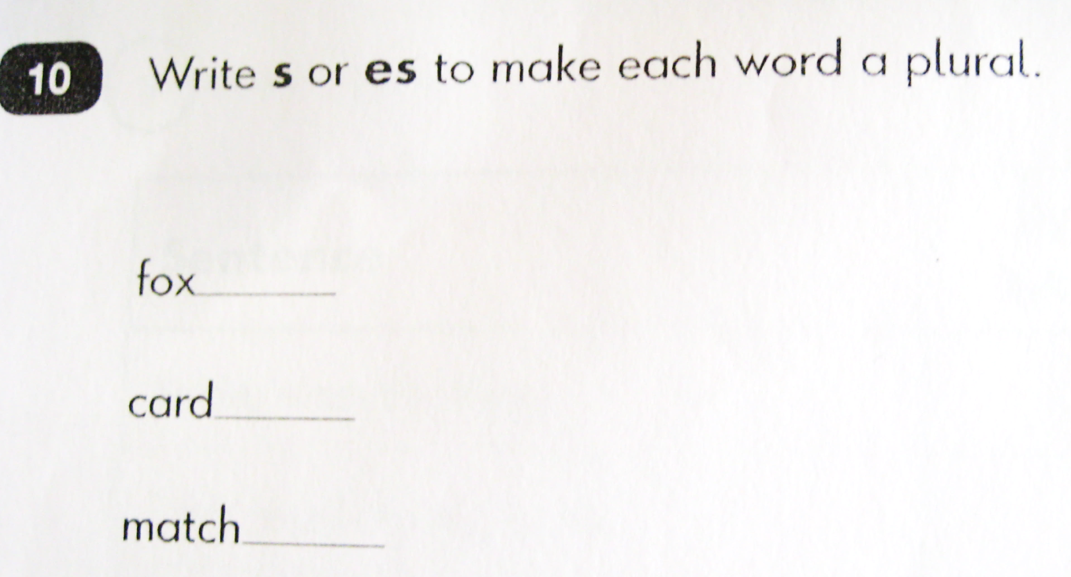
Grammar

Slide 25
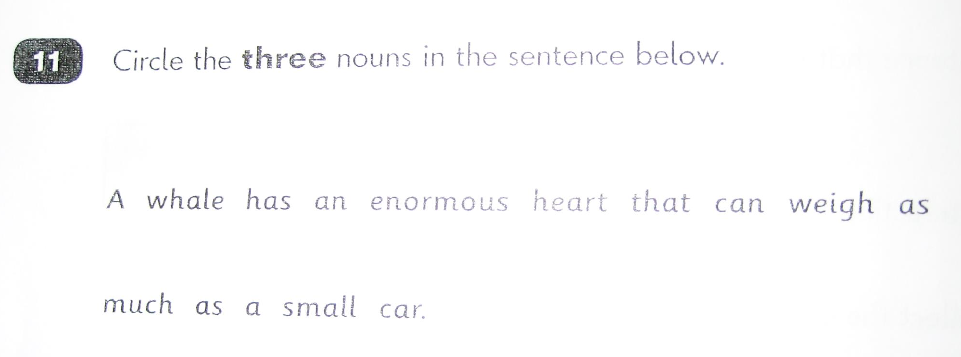
Grammar

Slide 26
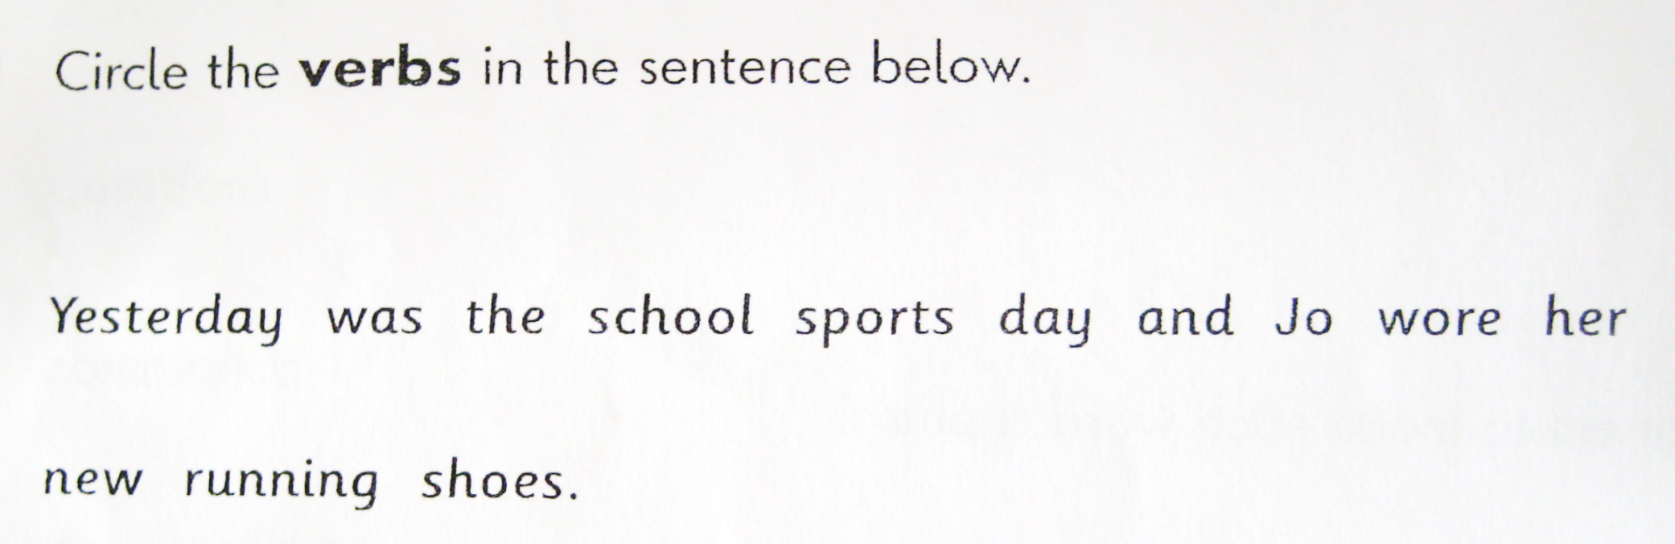
Grammar

Slide 27
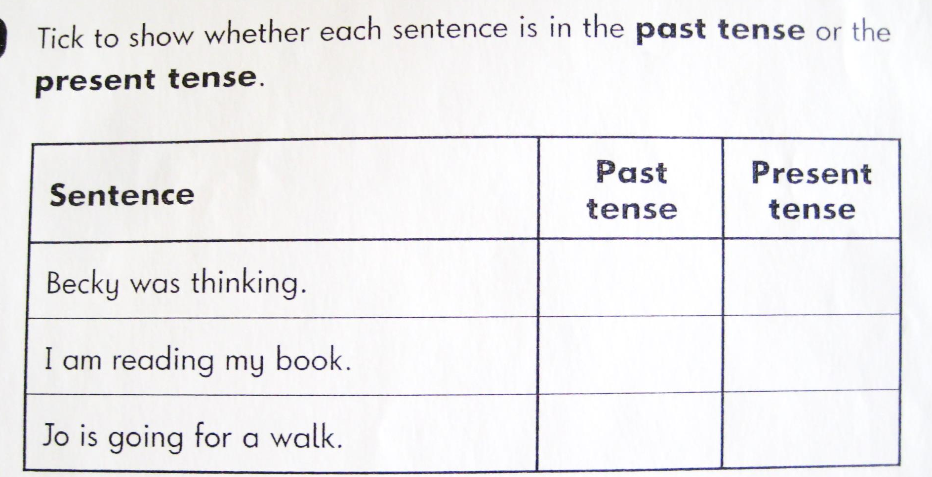
Grammar

Slide 28
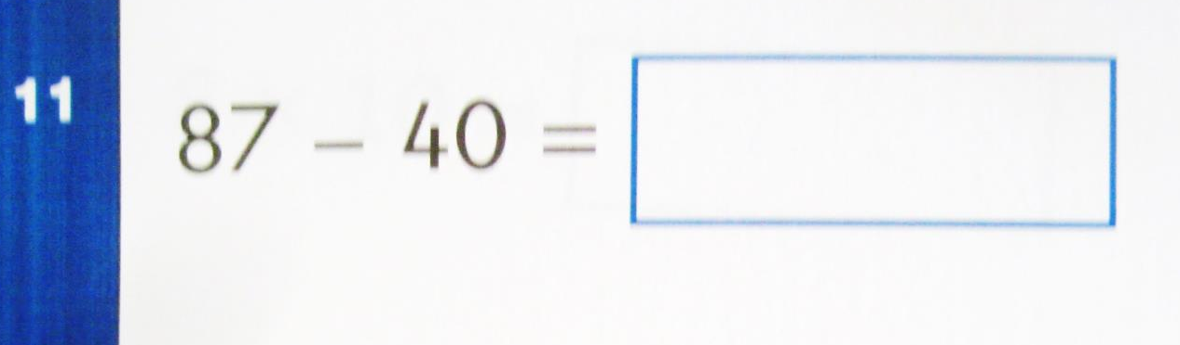
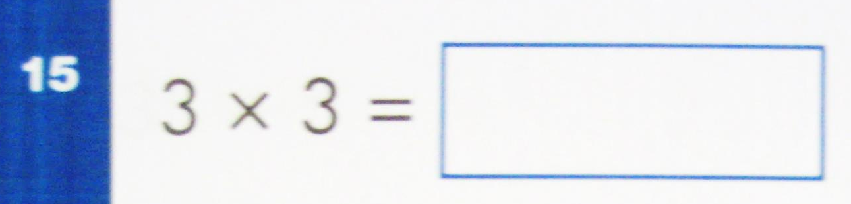
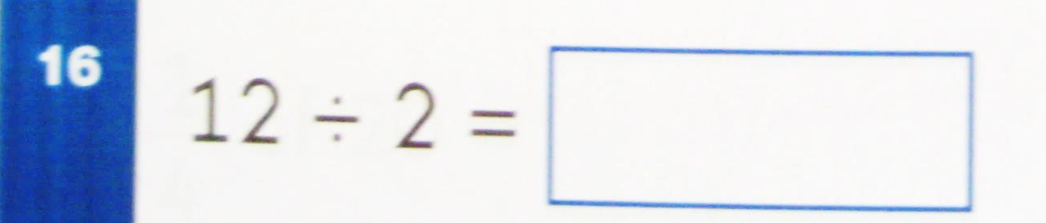
Mathematics

Slide 29
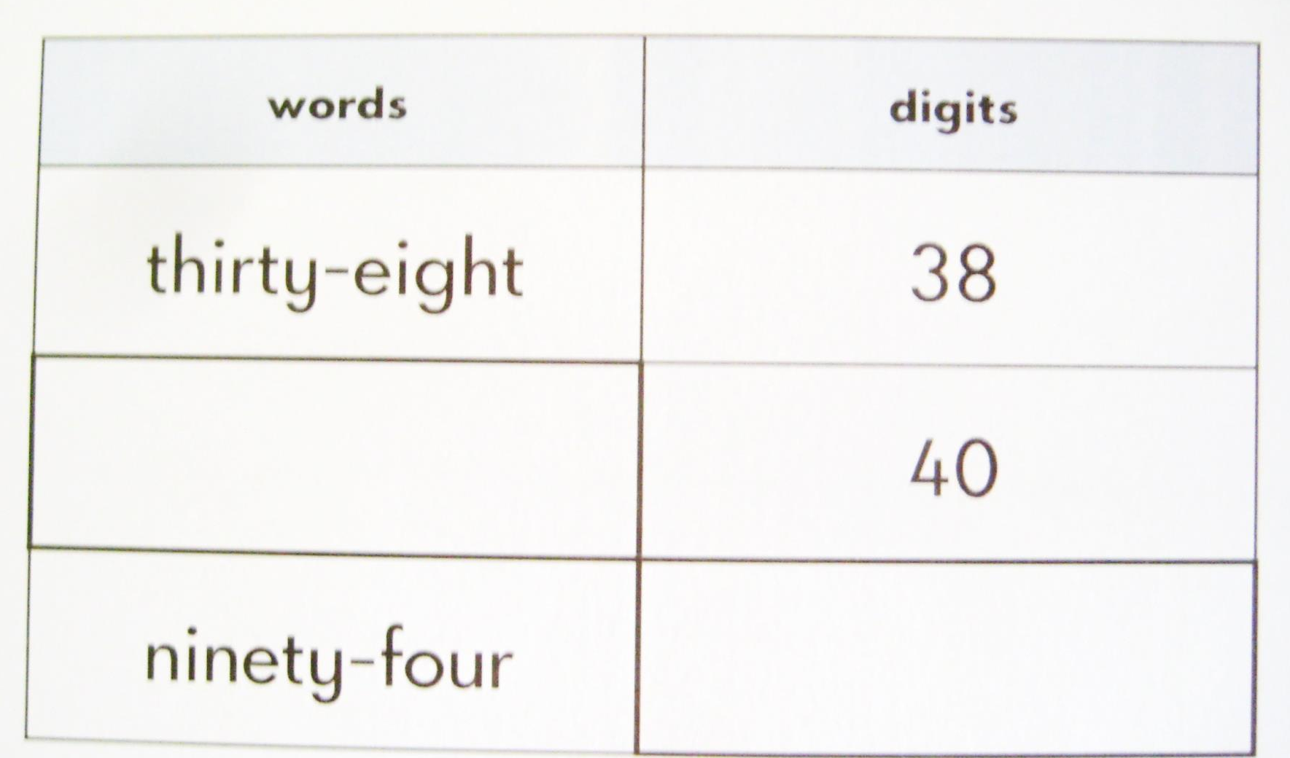
Mathematics

Slide 30
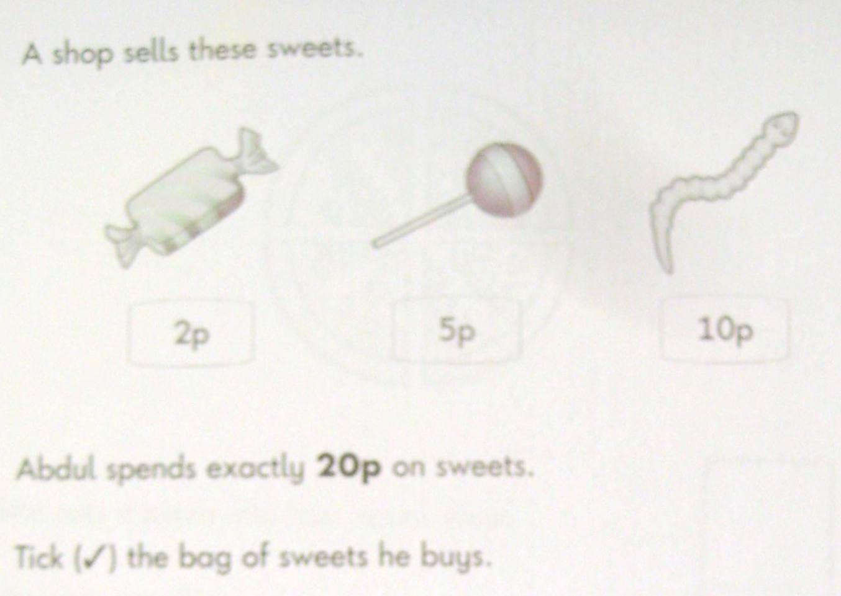
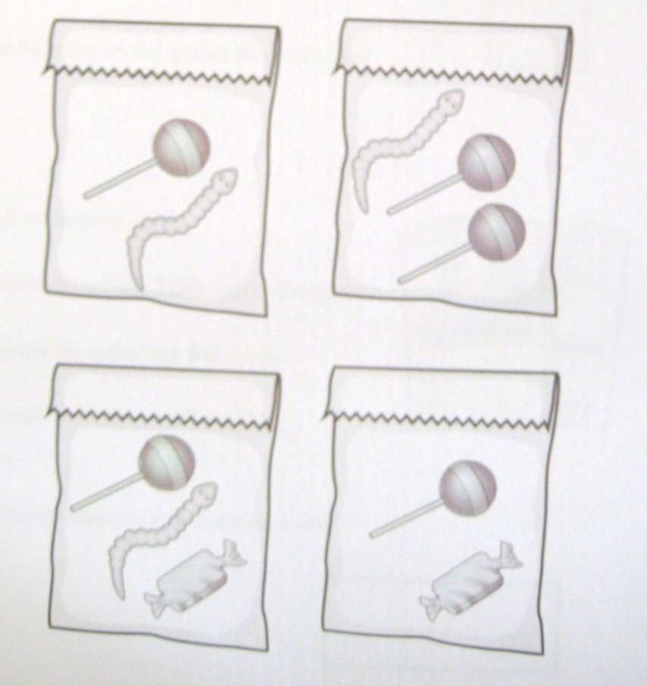
Mathematics

Slide 31
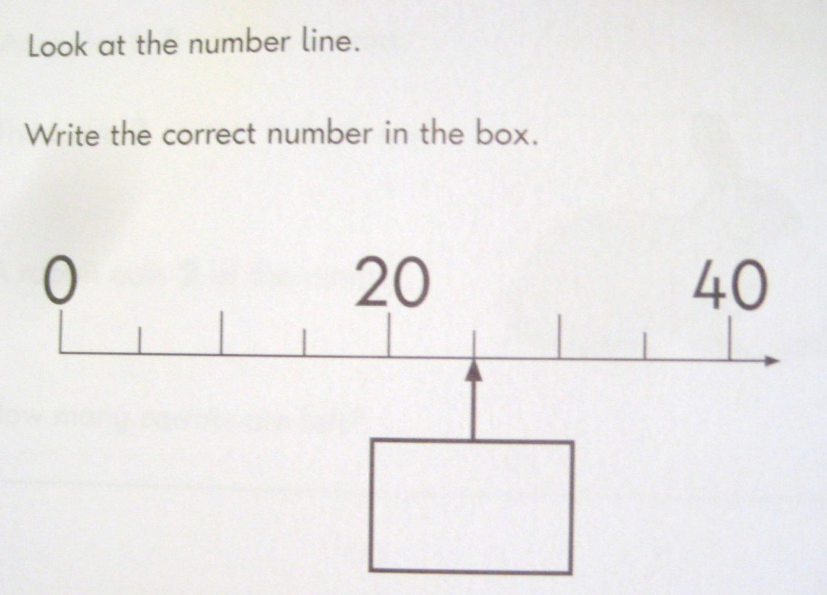
Mathematics

Slide 32
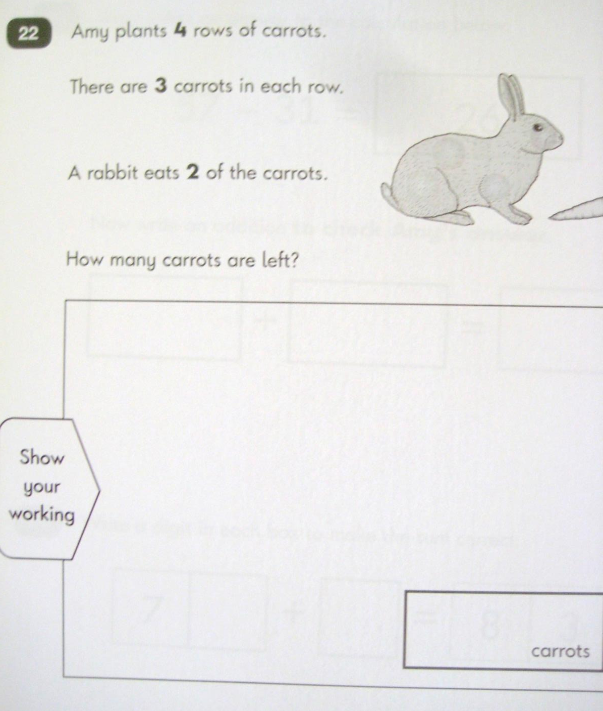
Mathematics

Slide 33
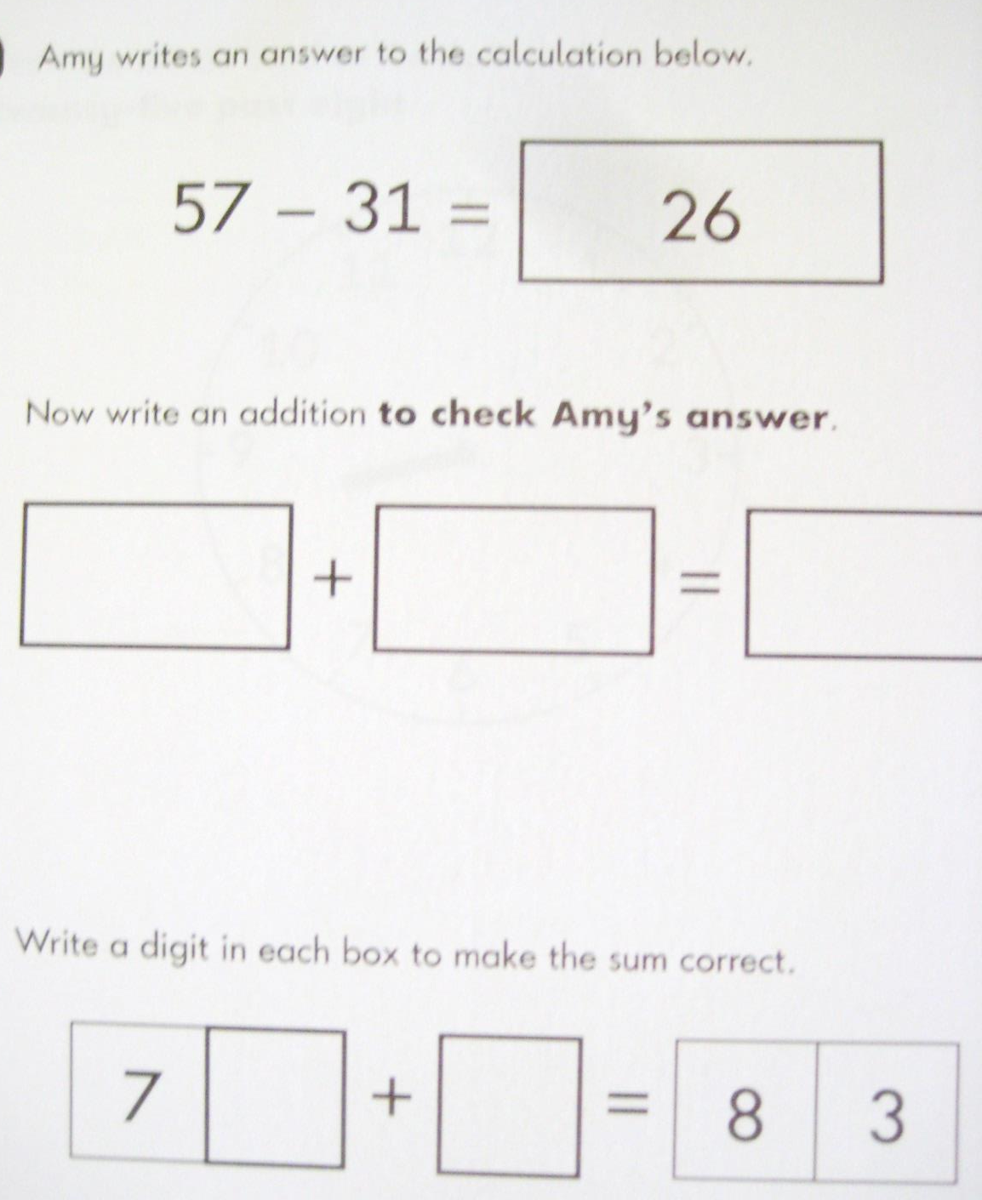
Mathematics

Slide 34
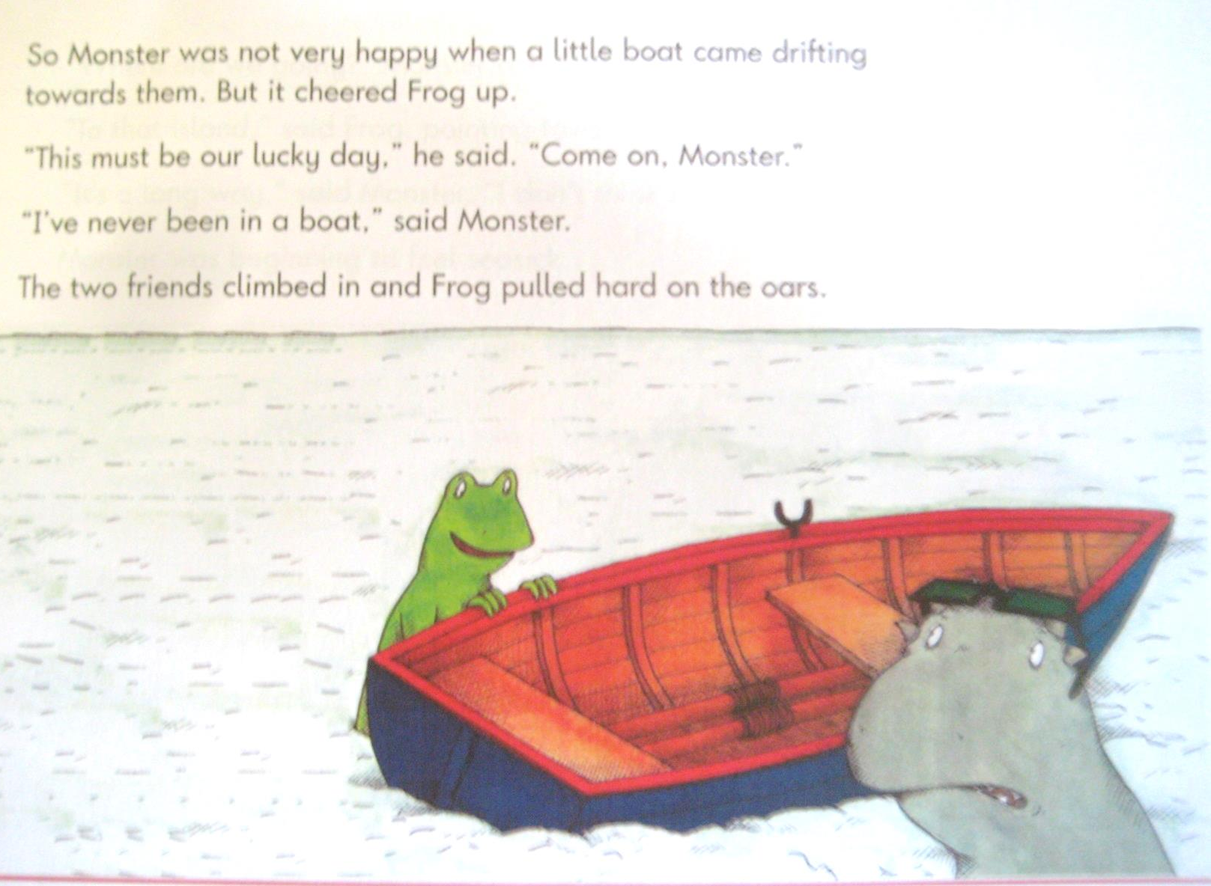
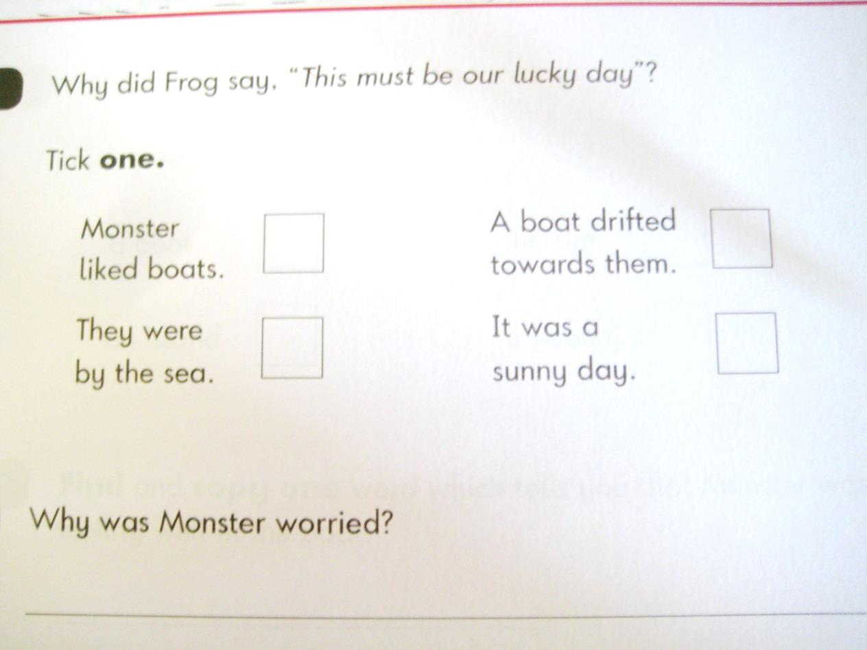
Reading

Slide 35
Please find spelling, reading skills and useful apps/websites amongst the handouts.☺
www.phonicsplay.com
www.topmarks.co.uk
www.primaryresources.co.uk

Slide 36
Safeguarding
At Tadley School, the welfare and safety of your child is paramount to us. You and your child/children are valued at our school and we wish to do everything we can to make sure you/they are safe and happy.
There are many measures we take in making sure your child is safe in and around school.
The School Site
Safety access codes are attached to the ‘exit’ gates and each member of staff has a key fob to enter or exit the building. The school is very secure and visitors can only access the school via the front entrance.
Staff Training
All of the staff at Tadley have annual safeguarding training which looks at all aspects of safeguarding. There are refresher courses and ongoing training throughout the year.
If you as a parent have any concerns regarding safeguarding at Tadley, in relation to your own child or any concerns you have regarding another child, please always report this to a member of staff. We will always take it seriously and look into the concern as best we can. Do not hesitate, even if you don’t think it’s a big deal!

Slide 37
How you can help us keep our school safe!
Parking:
Due to the school being built many years ago when Tadley was a much smaller town, there is not much allocated parking for the school. We understand that it can be difficult when picking up or dropping off your child. Please be aware of the ‘keep clear’ signs on the road and any other road markings. It can be extremely busy at the end of the school day and we advise that you greet your child on the playground and walk to your car with them. Please refrain from parking in the school car park at all times as this is for staff only.
Signing in:
If you volunteer at school whether this is for swimming, walking to the church or helping in class, please make sure you sign in using the iPad on the front desk and take a visitor sticker/lanyard.
It is very important that all staff are aware you are visiting the school as well as the office staff knowing that there are visitors in school in case of an evacuation e.g. fire.
Please, under no circumstances use the ‘side’ door during school hours. This door is used for the children in the morning and staff.

Slide 38
How you can help us keep our school safe!
Reading up on Safeguarding:
As part of your visiting induction time there are materials to read with regards to safeguarding in Tadley School. Please make sure you take time to read these before entering the classrooms in which you are based. It is important that all adults are fully aware of any procedures and protocols. This includes confidentiality.
Drop at the Door policy:
At Tadley, we try to create independent, happy children! In order to make them as independent as possible we encourage them to come into school on their own. This not only allows them time to speak to their friends before school but it also allows them the opportunity to realise they can do it! If you have any messages the staff at the door will be more than happy to pass them on. These messages do get to us before 9am! If the message is urgent we will contact you. Alternatively, you can write in your child’s blue communication book where we will write back to you if necessary.

Slide 39
How you can help us keep our school safe!
In order to keep our children safe anyone who works with the children will need to be DBS checked. This is a government check. No one will be on site working with your child without a DBS check.
Thank you for helping us keep your children safe. If you have any questions we will always be happy to answer them as best we can.

Slide 40
Thank you for coming!
We really hope you found this helpful and welcome any questions.

