Slide 1
WELCOME

Slide 2
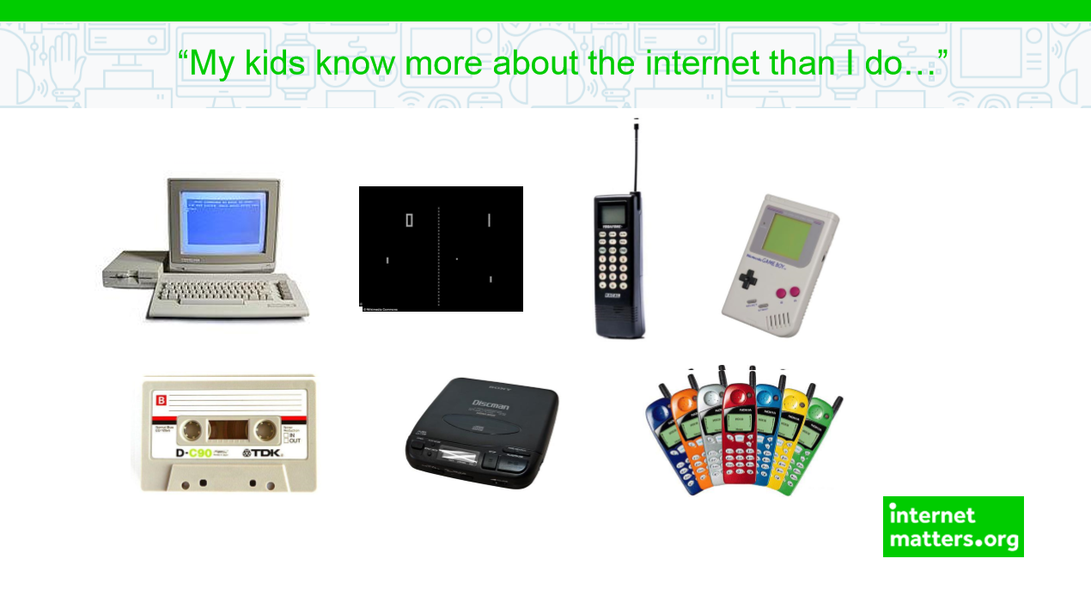

Slide 3
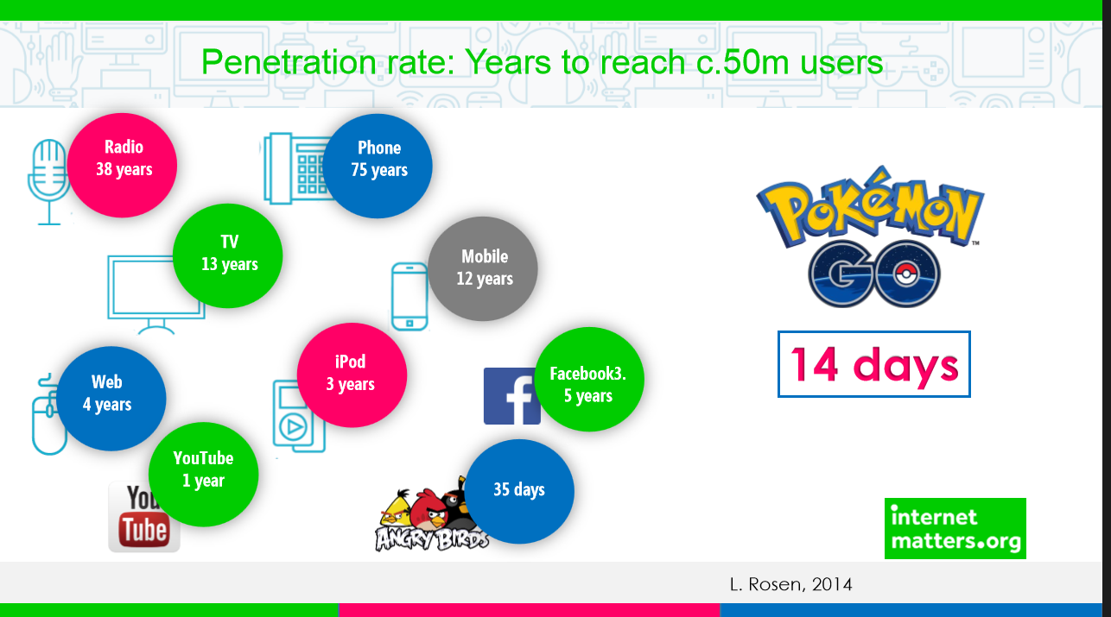

Slide 4


Slide 5
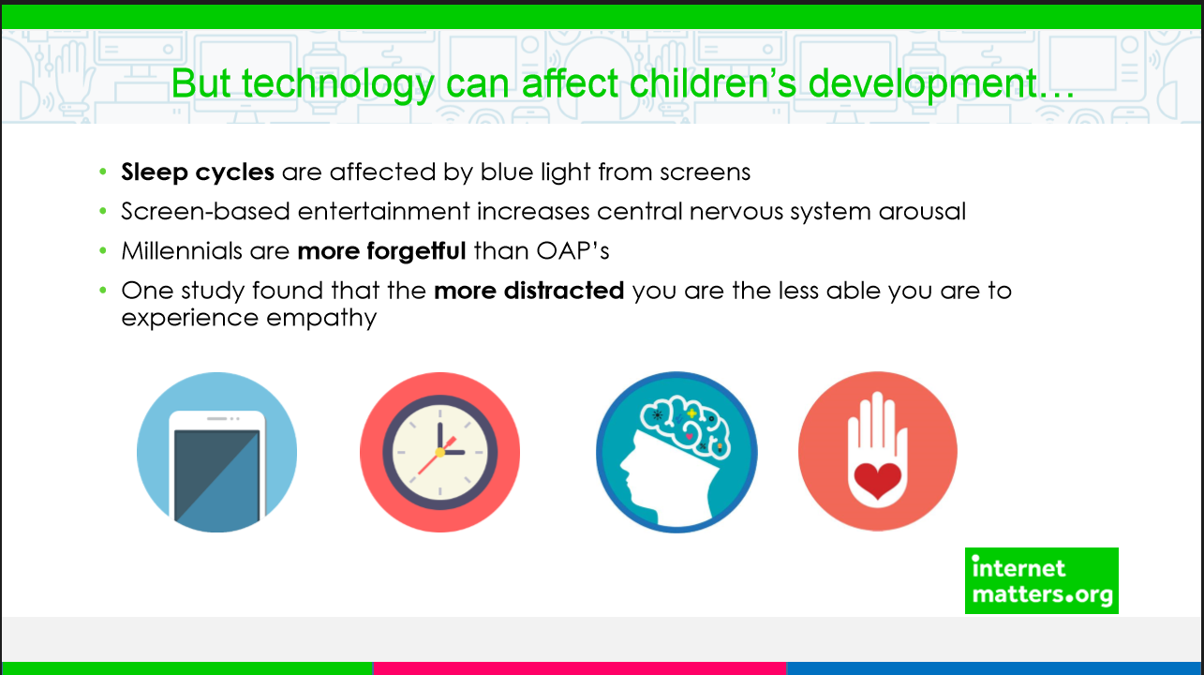

Slide 6
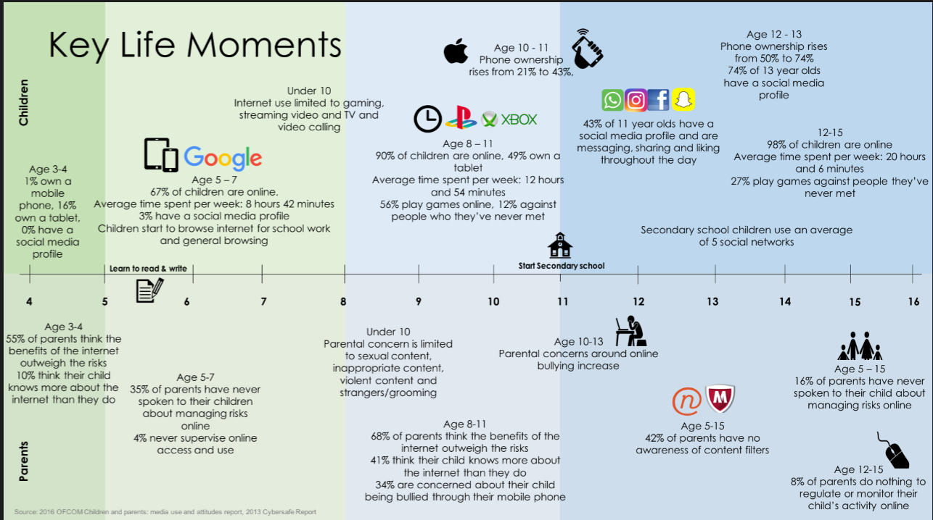

Slide 7
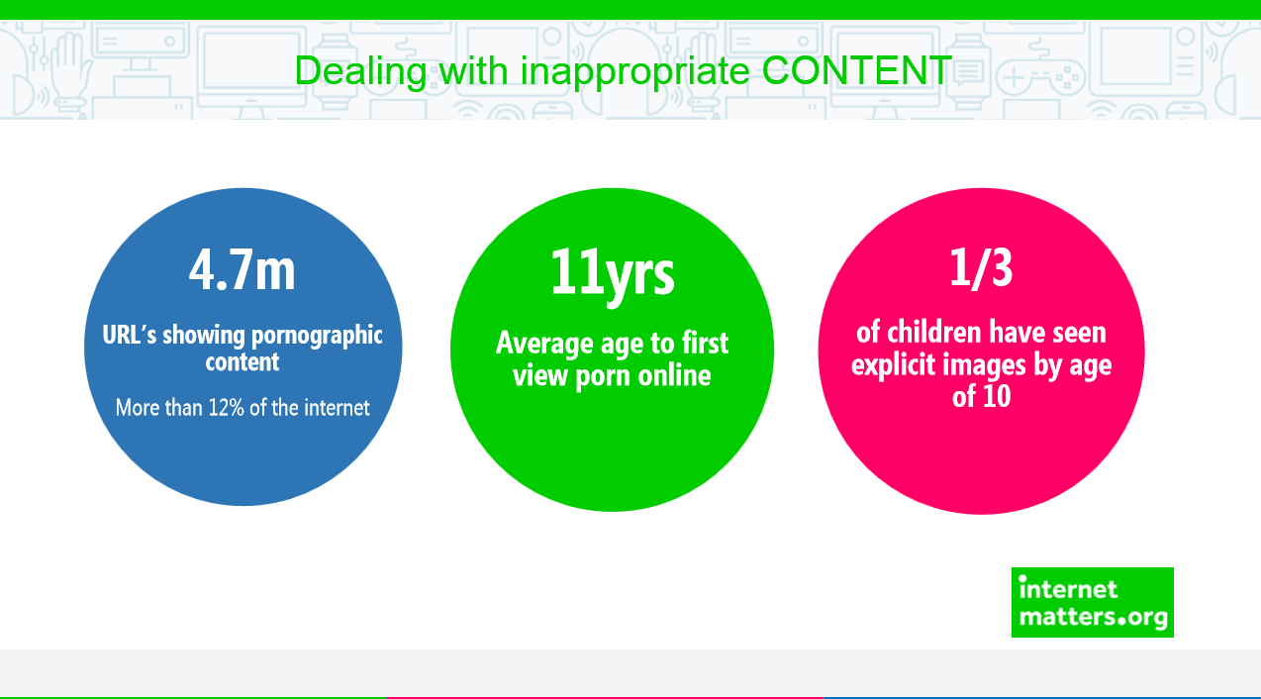

Slide 8
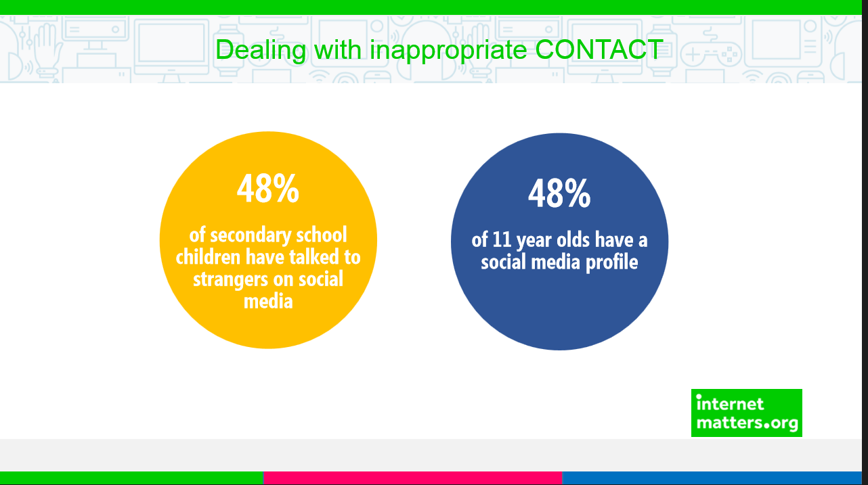

Slide 9
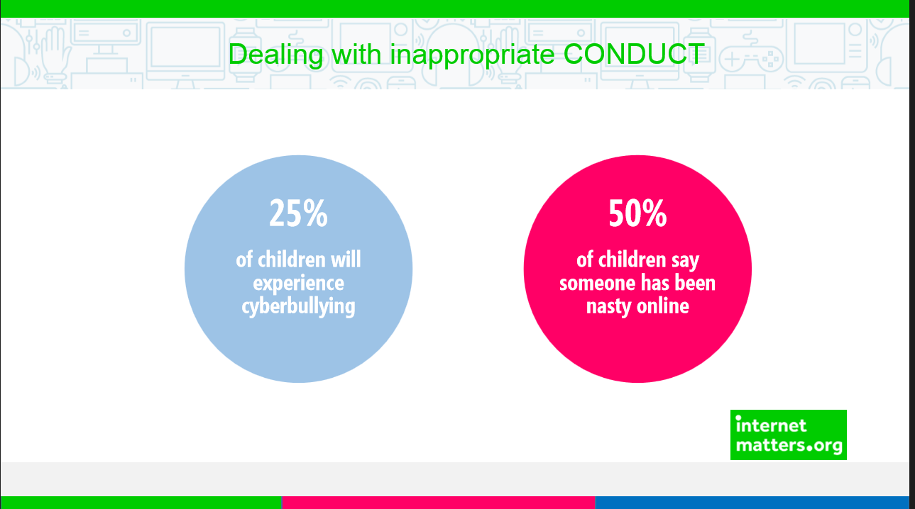

Slide 10
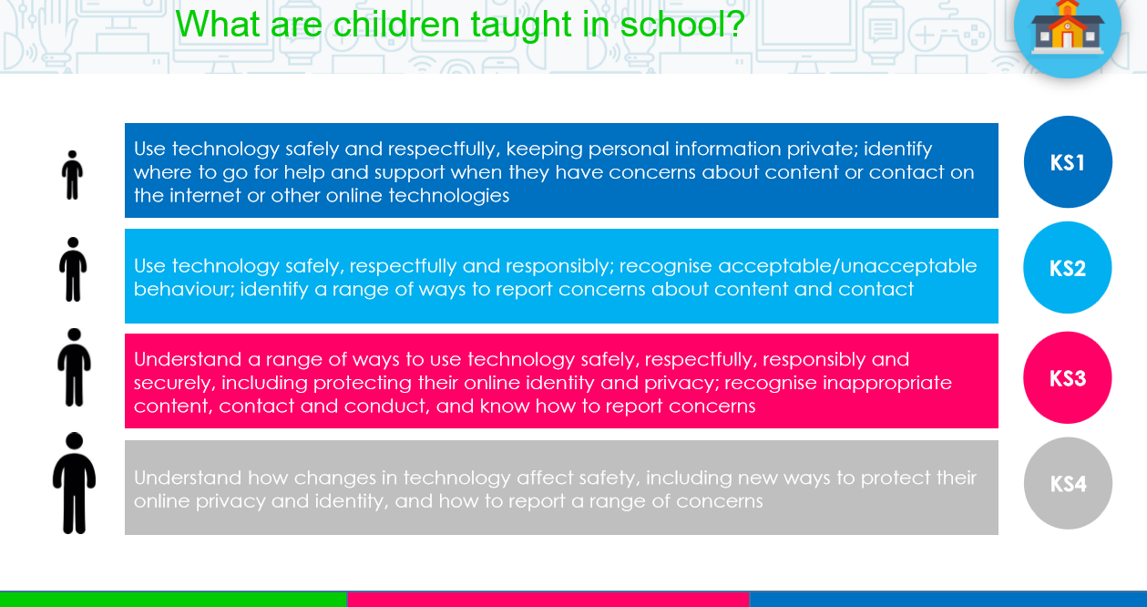

Slide 11
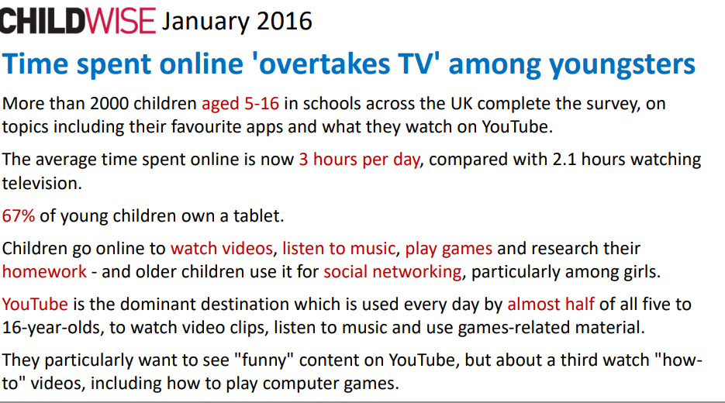

Slide 12
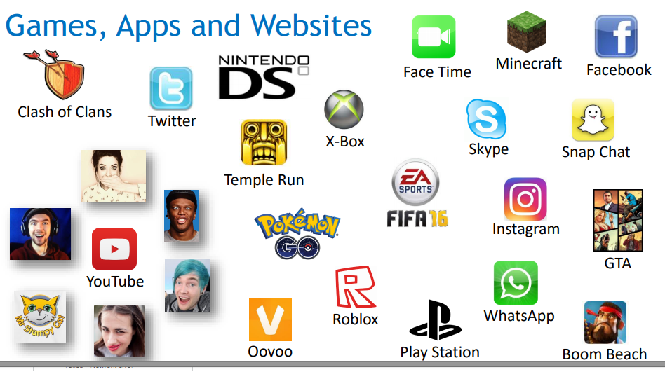

Slide 13

Apps & games…
Games where we talk to strangers:
Roblox
Whatsapp
Tik Tok
Minecraft
Kill shop bravo
World of cubes
YouTube
Instagram
Fortnite
Sea of thieves
Destiny 1 & 2
Fifa
Call of Duty
“Chat from strangers comes up on my screen but my Mum & Dad have told me that I am not allowed to chat back.”
Year 3 child.
“On the Xbox you can friend request random people and speak to them on chat. People add me and I can speak to them on my headphones if I want to. It’s funny to add random people.”
Year 4 child.
“Some people say mean things to me on games. Sometimes you can report them.”
Year 3 child.

Slide 14









Apps & games…
Minecraft
Jetpack joy ride
Fifa 19
Candy Crush
Onrush
Mario Bros
Hungry whales
Coin Master
Tetris
Minion Rush
The Crew
Blob
World of Cubes
Snapchat
Tik Tok
Year 3&4

Slide 15






Apps & games…
Helix Jump
Pokemon Go
Fortnite
YouTube
Roblox
Friv
Fifa
Netflix
Call of Duty Black Ops
Shadow Fight
Minecraft
Slices
Battle Lands Royale
Fruit Ninja
Coin master
Year 5&6

Slide 16

7 questions to ask your child…
Which apps/games are you using at the moment?
Which websites do you enjoy using? Why?
How does this game work? Can I play too?
Do you have any online friends?
Do you know where to go for help?
Do you know what your personal information is?
Do you know your limits?

Slide 17


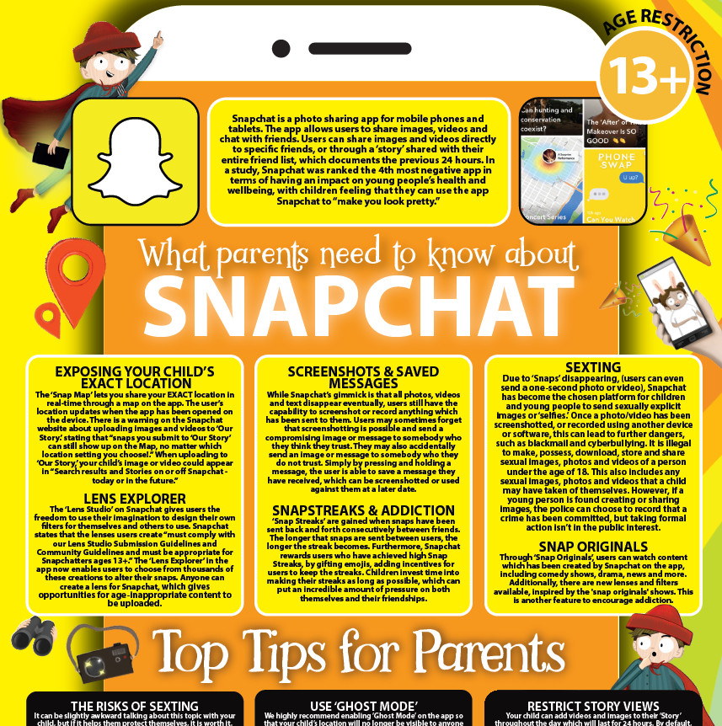

https://learning.nspcc.org.uk/research-resources/schools/share-aware-teaching/
https://nationalonlinesafety.com/resources/platform-guides/

Slide 18
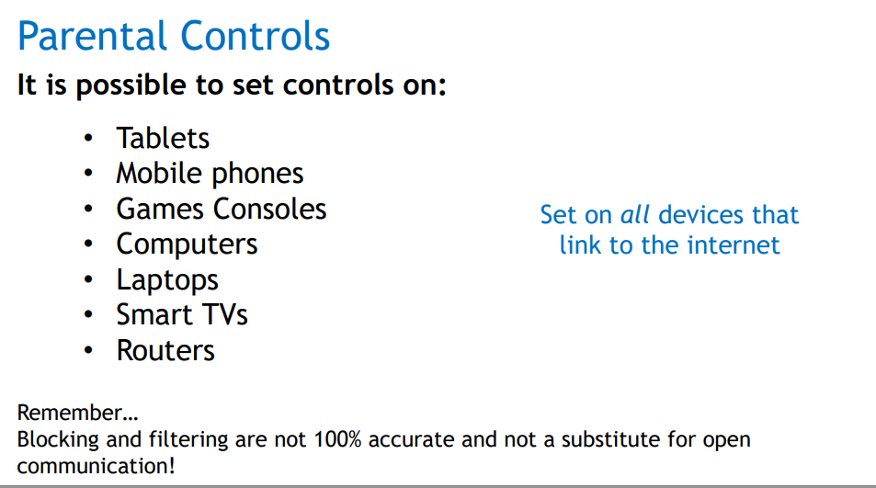

Slide 19
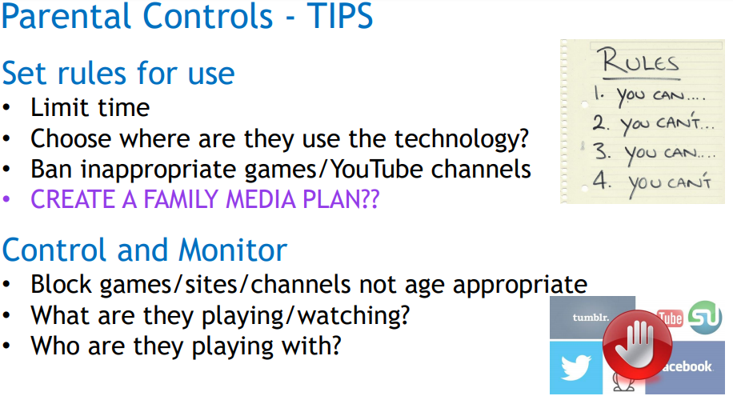

Slide 20
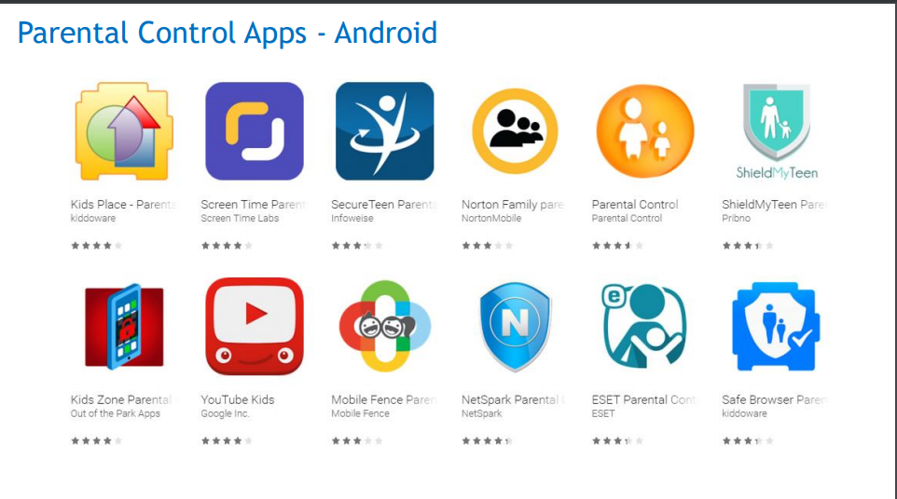

Slide 21
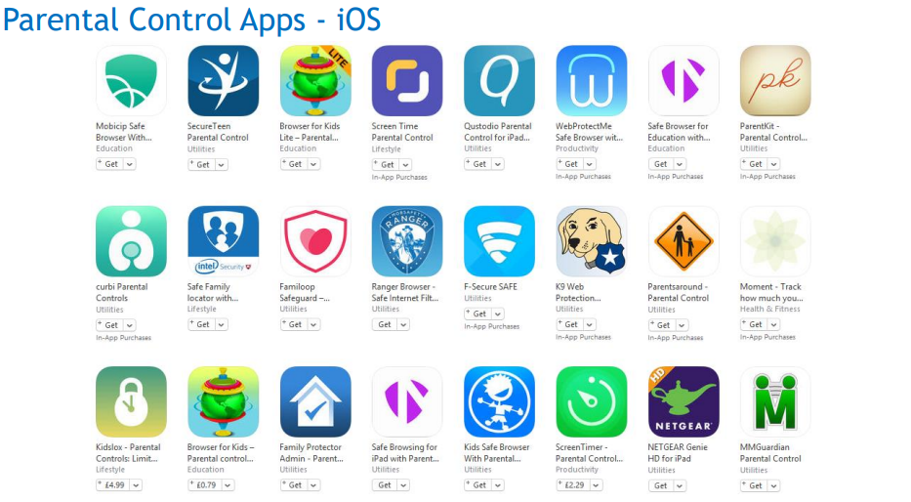

Slide 22
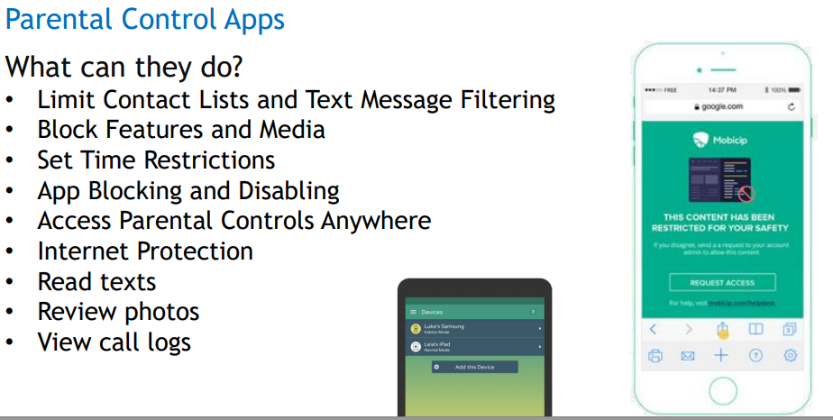

Slide 23
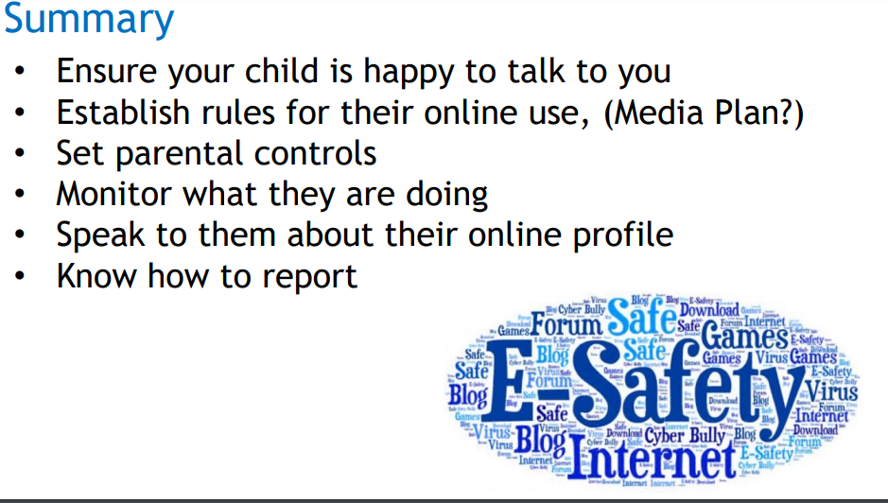

Slide 24
7 questions to ask your child…
Which apps/games are you using at the moment?
Which websites do you enjoy using? Why?
How does this game work? Can I play too?
Do you have any online friends?
Do you know where to go for help?
Do you know what your personal information is?
Do you know your limits?

Slide 25
https://learning.nspcc.org.uk/research-resources/schools/share-aware-teaching/

